Slide 1
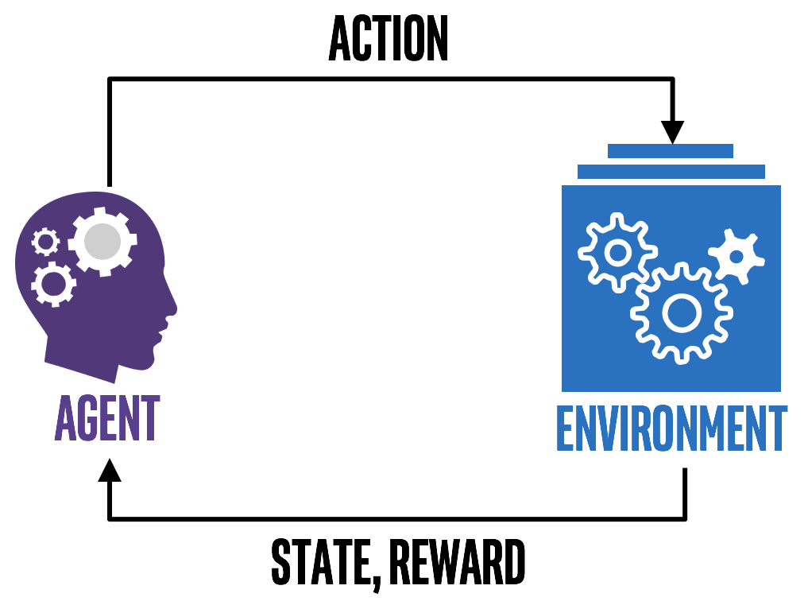
Fundamentals of Reinforcement Learning
Part-II
Notes:
1

Slide 2
R-SMART
Relaxed Semi-Markov Average reward Technique (R-SMART)
Notes:
2

Slide 3
R-SMART
Initialize Q-matrix, Max-Iterations, and Transition number $k$
Notes:
3

Slide 4
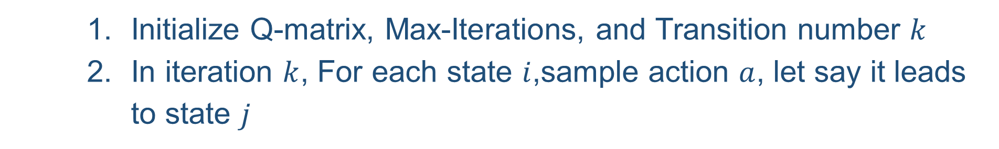
R-SMART
Initialize Q-matrix, Max-Iterations, and Transition number $k$
In iteration $k$, For each state $i$,sample action $a$, let say it leads to state $j$
Notes:
4

Slide 5
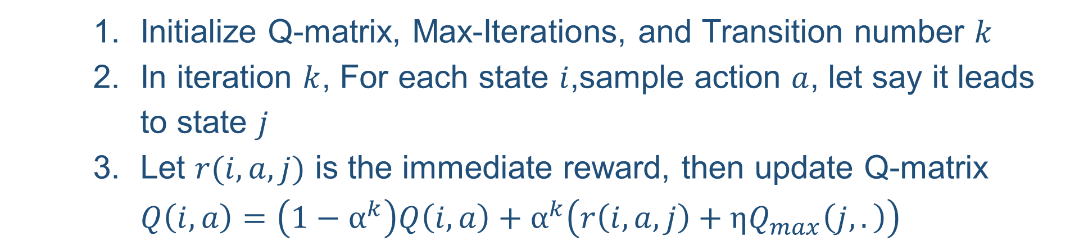
R-SMART
Initialize Q-matrix, Max-Iterations, and Transition number $k$
In iteration $k$, For each state $i$,sample action $a$, let say it leads to state $j$
Let $r(i,a,j)$ is the immediate reward, then update Q-matrix $Q\left(i,a\right)=\left(1−α^{k}\right)Q\left(i,a\right)+α^{k}\left(r\left(i,a,j\right)+ηQ_{max}\left(j,.\right)\right)$
Notes:
5

Slide 6
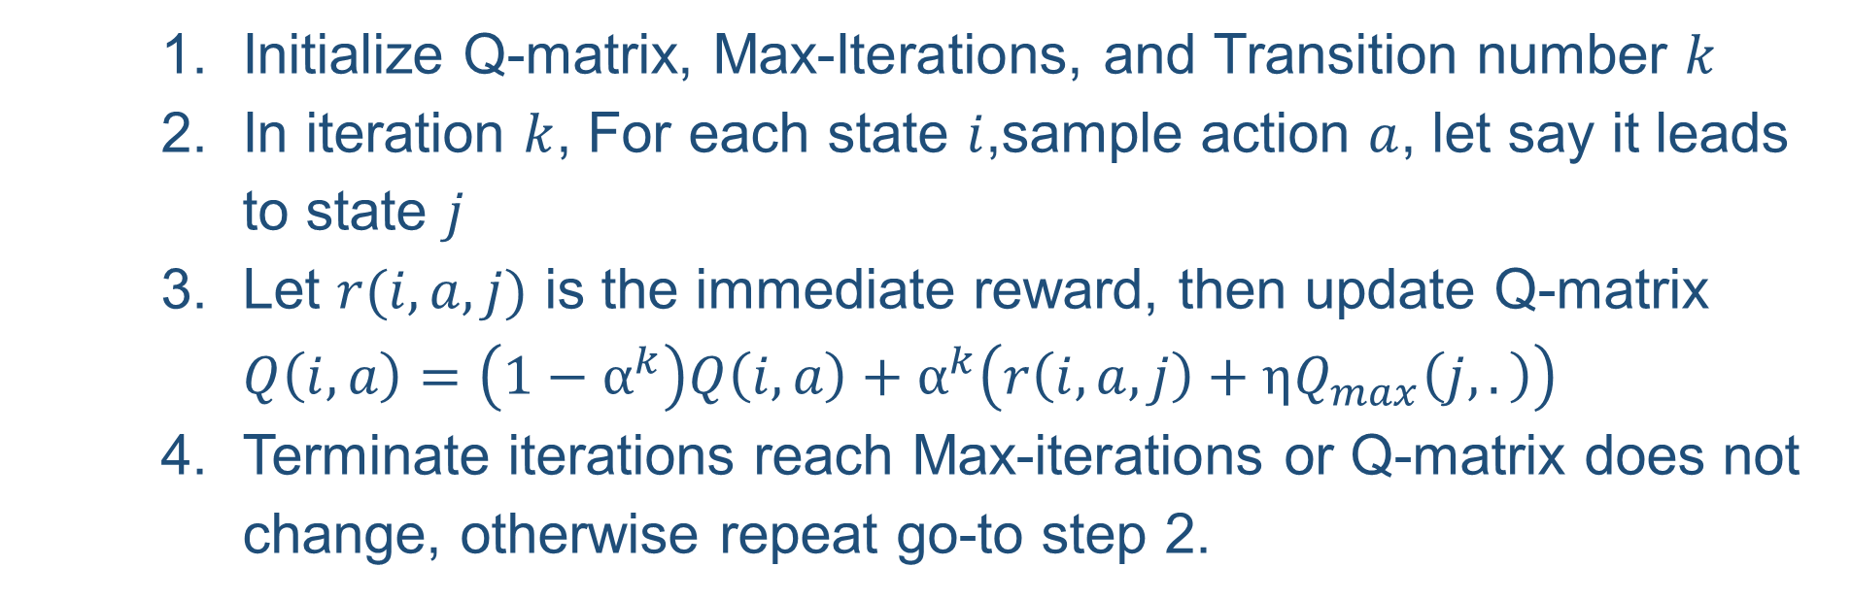
R-SMART
Initialize Q-matrix, Max-Iterations, and Transition number $k$
In iteration $k$, For each state $i$,sample action $a$, let say it leads to state $j$
Let $r(i,a,j)$ is the immediate reward, then update Q-matrix $Q\left(i,a\right)=\left(1−α^{k}\right)Q\left(i,a\right)+α^{k}\left(r\left(i,a,j\right)+ηQ_{max}\left(j,.\right)\right)$
Terminate iterations reach Max-iterations or Q-matrix does not change, otherwise repeat go-to step 2.
Notes:
6

Slide 7
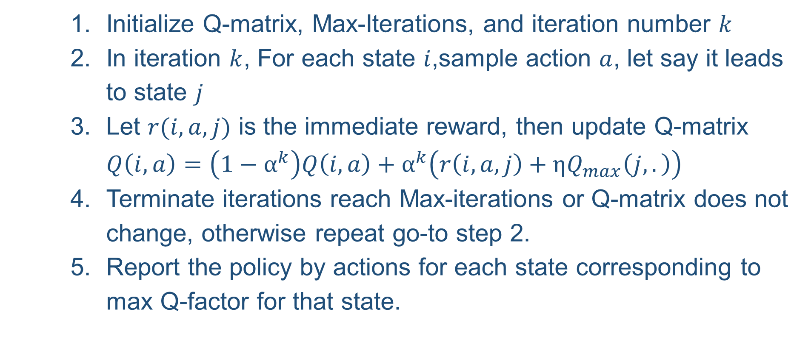
R-SMART
Initialize Q-matrix, Max-Iterations, and iteration number $k$
In iteration $k$, For each state $i$,sample action $a$, let say it leads to state $j$
Let $r(i,a,j)$ is the immediate reward, then update Q-matrix $Q\left(i,a\right)=\left(1−α^{k}\right)Q\left(i,a\right)+α^{k}\left(r\left(i,a,j\right)+ηQ_{max}\left(j,.\right)\right)$
Terminate iterations reach Max-iterations or Q-matrix does not change, otherwise repeat go-to step 2.
Report the policy by actions for each state corresponding to max Q-factor for that state.
Notes:
7

Slide 8
Example R-SMART
MAP-ROVER
 | 0 | 1 | 2 | 3 | 4 | 5 | 6 | 7 | 8
0 | 0 | 0 |  | 0
1 | 0 | 0 | 0 |  | 0
2 |  | 0 | 0 |  |  | 0
3 | 0 |  |  | 0 | 0 |  | 0
4 |  | 0 |  | 0 | 0 | 0 |  | 0
5 |  |  | 0 |  | 0 | 0 |  |  | 0
6 |  |  |  | 0 |  |  | 0 | 0
7 |  |  |  |  | 0 |  | 0 | 0 | 0
8 |  |  |  |  |  | 0 |  | 0 | 0
0 | 0 | 0
0 | -1 | 0
0 | 0 | 1
0 | 1 | 2
3 | 4 | 5
6 | 7 | 8
Notes:
8

Slide 9
What next?
Implementation of MAP-ROVER in Python
Notes:
9

